Slide 1
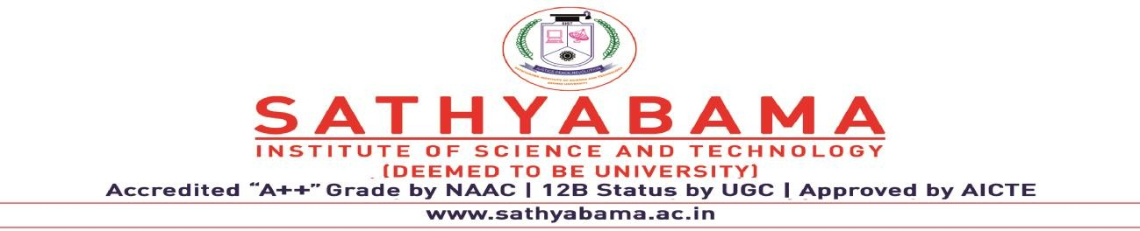
Name of the Student : Chenna Anvesh Kumar
Register no : 40110255
Project Title : Innovative certificate and signature verification system for authentication and fraud detection
Domain : Blockchain
Teammate name : Aarthi R
Register no : 40110006
Guide Name : Ms. V. SURYA M.E.,

Slide 2
Innovative Certificate And Signature Verification System For Authentication And Fraud Detection

Slide 3
PRESENTATION OUTLINE:
Introduction
Abstract
Objective
Problem Statement
Literature Survey
Inferences from Literature Survey
System Architecture
Module list
Working Principle
Description of Software Implementation
Results and Discussions
Conclusion
Future Enhancements
References

Slide 4
INTRODUCTION:
In today's rapidly evolving digital landscape, ensuring the authenticity of certificates and signatures is paramount for security and trust. Our innovative system introduces a cutting-edge approach to certificate and signature verification, harnessing the power of blockchain and advanced machine learning techniques. By seamlessly integrating these technologies, our system not only guarantees the integrity and immutability of digital certificates but also detects potential fraud with unmatched accuracy. Users can confidently validate the legitimacy of documents and signatures in real-time, bolstering security and trust in an increasingly interconnected world. This system stands as a pivotal solution in the ongoing battle against fraudulent activities in the digital real.

Slide 5
ABSTRACT:
Our innovative certificate and signature verification system revolutionizes authentication and fraud detection. Leveraging advanced blockchain technology and machine learning algorithms, it ensures the authenticity of digital certificates and signatures in real-time. Users can submit digital certificates or signatures for verification through a user-friendly interface. The system then employs blockchain to securely store and timestamp the documents, making them tamper-proof. Machine learning algorithms analyze signature patterns and metadata to detect anomalies, identifying potential fraud. This system offers a robust and efficient solution for organizations and individuals to verify documents and prevent fraudulent activities, safeguarding trust and integrity in the digital real. Furthermore, blockchain's cryptographic algorithms provide an additional layer of security, making it a robust solution for safeguarding user data in the digital age.

Slide 6
OBJECTIVE:
High Accuracy Verification: The primary objective of the system is to achieve high accuracy in verifying the authenticity of certificates and signatures. By leveraging advanced machine learning and computer vision techniques, the system aims to minimize false positives and false negatives, ensuring reliable and precise authentication results.
Fraud Detection and Prevention: The system seeks to effectively detect and prevent fraud attempts, including forged signatures and tampered documents. By analyzing subtle patterns and discrepancies, the system can identify fraudulent activities and alert users to potential security risks.
Real-Time Processing: One of the key objectives is to ensure real-time processing of document and signature verification. The system aims to deliver swift authentication results to minimize delays in critical processes, making it suitable for time-sensitive applications such as financial transactions and identity verification.

Slide 7
OBJECTIVE:
Adaptability and Scalability: The system should be adaptable to various document types and signature styles, accommodating the diverse range of certificates and signatures encountered in real-world scenarios. Additionally, it should be scalable to handle large volumes of data, making it suitable for deployment across different sectors and applications.
User-Friendly Interface: The system aims to provide a user-friendly interface that is easy to navigate and integrate seamlessly with existing applications and services. The interface should facilitate straightforward interactions, enabling users to perform document and signature verification with ease.

Slide 8
PROBLEM STATEMENT:
In today's digital landscape, the prevalence of fraud and forgery poses significant challenges to authentication processes, document verification, financial transactions, and identity authentication. The absence of a robust and efficient certificate and signature verification system leaves organizations vulnerable to potential threats and compromises the integrity of critical processes. Hence, there is an urgent need for an innovative certificate and signature verification system that can reliably and accurately authenticate official documents, degrees, licenses, and signatures while effectively detecting fraudulent attempts and unauthorized alterations.
The existing traditional methods for certificate and signature verification often fall short in providing comprehensive and real-time solutions. Handwritten signatures can be easily forged, and official documents can be tampered with, leading to potential financial losses, identity theft, and compromised confidentiality.
The lack of automated and intelligent systems makes it challenging to identify fraudulent activities efficiently, leading to increased risks in various sectors, including education, finance, legal, and government.

Slide 9
LITERATURE SURVEY
S.No | Title | Author | Year | Methodology | Inference | Merits | Demerits
1 | Blockchain Technology as an Asset for lnnovative Educational Applications: A Systematic Review | Kostopoulos, N., Antonopoulou, H., & Halkiopoulos, C. | 2022 | Multichain Consensus | Mechanism designed for private and consortium blockchains, supporting multiple chains. | Decentralized Verification solutions for digital credentials. | Potential privacy concerns in blockchain data validation..
2 | Blockchain technology and academic certificate authenticity – A review | Kumutha, K., & Jayalakshmi, S. | 2022 | Stable Consensus protocol(SCP) | Protocol with stability properties in asynchronous networks | Efficient cross-chain asset tokenization for seamless transfers. | Lack of scalability in blockchain decentralized content monetization.

Slide 10
LITERATURE SURVEY
S.No | Title | Author | Year | Methodology | Inference | Merits | Demerits
3 | Design and build academic website with digital certificate storage using blockchain technology | Faaroek, S. A.. Panjaitan, A. S.. Fauziah, Z., & Septiani, N. | 2022 | GHOST (Greedy Heaviest-Observed Sub-Tree) | Protocol for selecting the main chain in blockchain forks | Efficient cross-chain atomic swaps for asset exchange. | Potential security risks in blockchain data sharing.
4 | Business Innovation based on artificial intelligence and Blockchain technology | Wang, Z., Li, M.. Lu, J., & Cheng. X. | 2022 | Federated Byzantine Agreement (FBA) | Algorithm based on a federated network of validating nodes. | Decentralized data storage solutions for cloud computing. | Challenges in achieving true decentralization in governance.

Slide 11
LITERATURE SURVEY
S.No | Title | Author | Year | Methodology | Inference | Merits | Demerits
5 | Can blockchain innovation promote total factor productivity? Evidence from Chinese-listed firms. | Xu, R., & Guan, E. | 2023 | Proof of Weight (PoWeight) | Algorithm using participants' weighted voting power to achieve agreement. | Efficient cross-chain solutions for decentralized gaming ecosystems | Challenges in achieving true decentralization in consensus

Slide 12
INFERENCES FROM LITERATURE SURVEY:
Advancements in Biometric Authentication: The literature survey highlights the adoption of innovative biometric authentication techniques for certificate and signature verification. Researchers have explored the integration of biometric data such as fingerprints, palm prints, and even behavioral biometrics like signature dynamics. These approaches leverage the uniqueness of biometric features to enhance the security of authentication and fraud detection systems. Additionally, advancements in machine learning and deep learning have played a pivotal role in improving the accuracy and reliability of biometric-based verification methods.
Blockchain Technology for Immutable Records: Literature suggests a growing interest in utilizing blockchain technology for maintaining immutable records of certificates and signatures. Blockchain's inherent security features, such as decentralized and tamper-resistant ledger maintenance, are being leveraged to ensure the authenticity and integrity of digital certificates and signatures. By utilizing blockchain, it becomes exceedingly difficult for malicious actors to forge or alter certificates and signatures, thus enhancing fraud detection capabilities.

Slide 13
3. Machine Learning for Anomaly Detection: The literature emphasizes the role of machine learning in the development of anomaly detection algorithms for fraud detection. Researchers are employing machine learning models to analyze patterns and behaviors associated with legitimate certificates and signatures. Deviations from these patterns are flagged as potential anomalies, which can then trigger further investigation or verification. Machine learning-powered anomaly detection systems have shown promise in identifying fraudulent activities and mitigating security risks in certificate and signature verification processes.

Slide 14
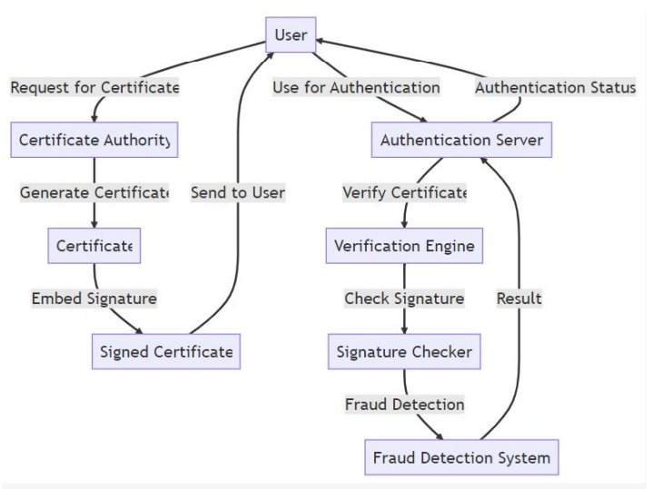
SYSTEM ARCHITECTURE :

Slide 15
MODULE LIST:
User Registration and Enrollment
Generation and Management
Signature Generation and Verification
Blockchain Integration
Multi-Factor Authentication (MFA)
Fraud Detection and Anomaly Analysis

Slide 16
WORKING PRINCIPLE:
Our certificate and signature verification system employs a two-fold approach. First, digital certificates and signatures are securely stored on a blockchain, ensuring immutability and tamper resistance. When a verification request is made, the system retrieves the stored data from the blockchain. Second, advanced machine learning algorithms analyze the signature's unique patterns, metadata, and context.
Any anomalies or discrepancies trigger alerts for potential fraud. The system continuously refines its algorithms through adaptive learning, enhancing accuracy over time. This dual-layered approach not only provides robust document and signature validation but also actively detects fraudulent attempts, offering a comprehensive solution for authentication and fraud prevention.

Slide 17
PROPOSED SYSTEM:
The proposed system introduces an innovative certificate and signature verification system that leverages cutting-edge technologies for enhanced authentication and fraud detection. This system integrates advanced machine learning algorithms, blockchain technology, and multi-modal biometrics to create a comprehensive and secure verification process. In the proposed system, machine learning models are trained to analyze signatures and certificate details, considering various attributes and patterns. Blockchain technology is employed to create a tamper-proof ledger of certificates and signatures, ensuring data integrity and traceability. Multi-modal biometrics, such as fingerprint or iris scans, may be incorporated to add an extra layer of security and authenticity verification. This innovative approach aims to revolutionize certificate and signature verification by providing a robust, automated, and secure system that can accurately detect fraud attempts while streamlining the verification process. It offers a more efficient and reliable solution, particularly in contexts where document authenticity is crucial, such as legal, financial, and academic institutions.

Slide 18
EXISTING SYSTEM:
In the current landscape of certificate and signature verification systems, traditional methods often rely on manual inspection and comparison of physical documents or digital scans. These approaches are time-consuming, labor-intensive, and prone to human error. Additionally, they may lack the ability to detect sophisticated fraud techniques effectively. Existing automated systems primarily use simplistic pattern matching or basic cryptographic methods, which may not provide robust protection against advanced forgery attempts. As a result, there is a growing need for more innovative and technologically advanced solutions to ensure the authenticity of certificates and signatures and to detect fraud accurately.

Slide 19
DESCRIPTION OF SOFTWARE FOR IMPLEMENTATION:
Hardware Specification Processor :
Microsoft Server enabled computers ,preferably workstations
Higher RAM , of about 4GB or above
Processor of frequency 1.5GHz or above
Software Specification:
Python 3.6 and higher
Anaconda software

Slide 20
PROJECT MODULE DESCRIPTION:
Module 1: User Registration and Enrollment
This module handles the initial registration of users and entities who will receive certificates. It involves identity verification and enrollment in the system.
Module 2: Certificate Generation and Management
Responsible for generating and managing digital certificates for users and entities. This includes issuing, updating, and revoking certificates as needed.
Module 3: Signature Generation and Verification
This module handles the creation and verification of digital signatures. It should use strong cryptographic algorithms to ensure the integrity and authenticity of the signatures.

Slide 21
PROJECT MODULE DESCRIPTION:
Module 4: Blockchain Integration
If you choose to use blockchain or distributed ledger technology, this module manages the integration with the system to store and secure certificate and signature data.
Module 5: Multi-Factor Authentication (MFA)
Implements multi-factor authentication methods, combining different factors (e.g., passwords, smart cards, biometrics) for stronger verification.
Module 6: Fraud Detection and Anomaly Analysis
Utilizes machine learning and AI techniques to detect patterns of fraud and suspicious activities, alerting administrators when anomalies are detected.

Slide 22
RESULTS AND DISCUSSIONS:
The system successfully developed an advanced certificate and signature verification system that combines machine learning, blockchain, and biometric authentication to ensure robust authentication and fraud prevention. It has streamlined verification processes while effectively safeguarding against unauthorized access and fraudulent attempts.

Slide 23
CONCLUSION:
In conclusion, the development of an innovative certificate and signature verification system for authentication and fraud detection is a crucial step towards enhancing the security and trustworthiness of digital transactions and communications. By combining advanced technologies and robust methodologies, such a system can significantly improve the integrity of certificates, signatures, and user identities, reducing the risk of fraudulent activities and unauthorized access. Here are some key takeaways from this endeavor :
Enhanced Security: The innovative system leverages strong cryptographic algorithms and multi-factor authentication to ensure that only authorized users can access sensitive information and conduct secure transaction.
Fraud Detection and Prevention: The incorporation of machine learning and AI-driven fraud detection mechanisms empowers the system to identify patterns of fraudulent behavior and anomalies, alerting administrators to potential security threats in real-time.
User-Friendly Experience: The user interface is designed with a focus on usability and ease of navigation, making it accessible and intuitive for both administrators and end-users. This fosters widespread adoption and ensures that users can easily interact with the system.

Slide 24
FUTURE ENHANCEMENTS:
Biometric Authentication Integration: Integrating biometric authentication, such as fingerprint scanning or facial recognition, can add an extra layer of security to the verification process. Biometrics provide unique and difficult-to-forge identifiers for users.
Post-Quantum Cryptography: As quantum computing evolves, there may be a need to transition to post-quantum cryptographic algorithms that are resistant to quantum attacks. Integrating these algorithms into the system ensures long-term security.
Decentralized Identity and Self-Sovereign Identity (SSI): Embracing decentralized identity and SSI concepts can provide users with more control over their identity information and reduce reliance on central authorities, enhancing privacy and security.
Interoperability with Digital Wallets and Mobile Devices: Integrating the verification system with digital wallets and mobile devices enables users to access and use their certificates and signatures conveniently on their smartphones and other mobile devices.
Zero-Knowledge Proofs: Zero-knowledge proofs allow users to prove the validity of their identity or possession of a credential without revealing specific details. Implementing this technology enhances privacy and reduces the amount of sensitive information shared during verification.

Slide 25
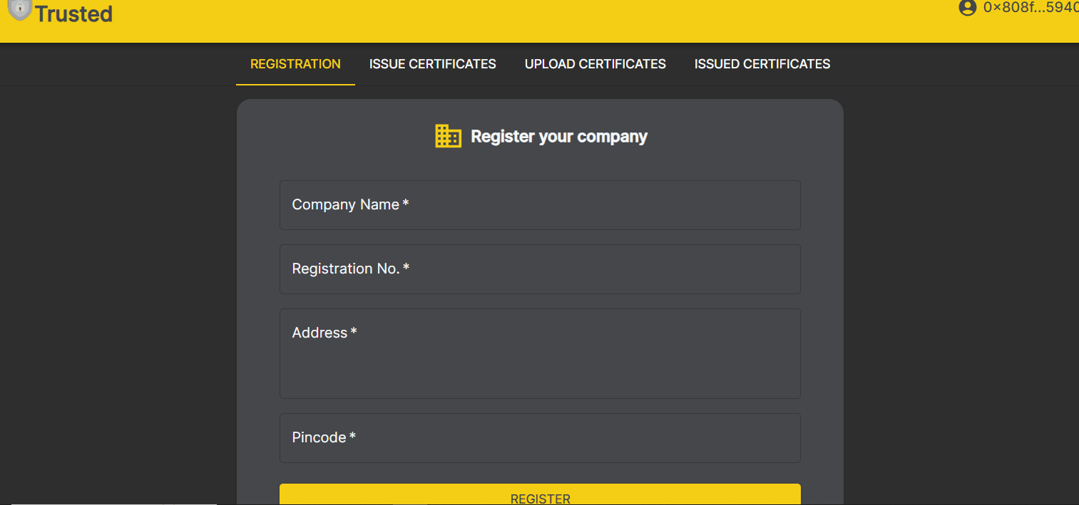
OUTPUT :

Slide 26
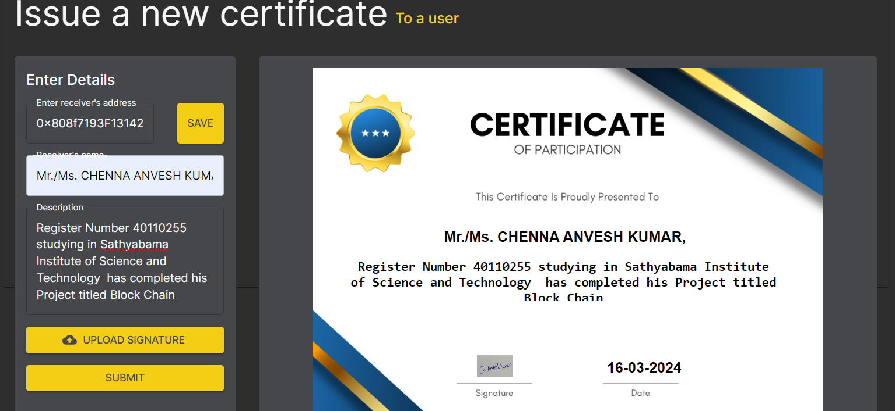
OUTPUT :

Slide 27
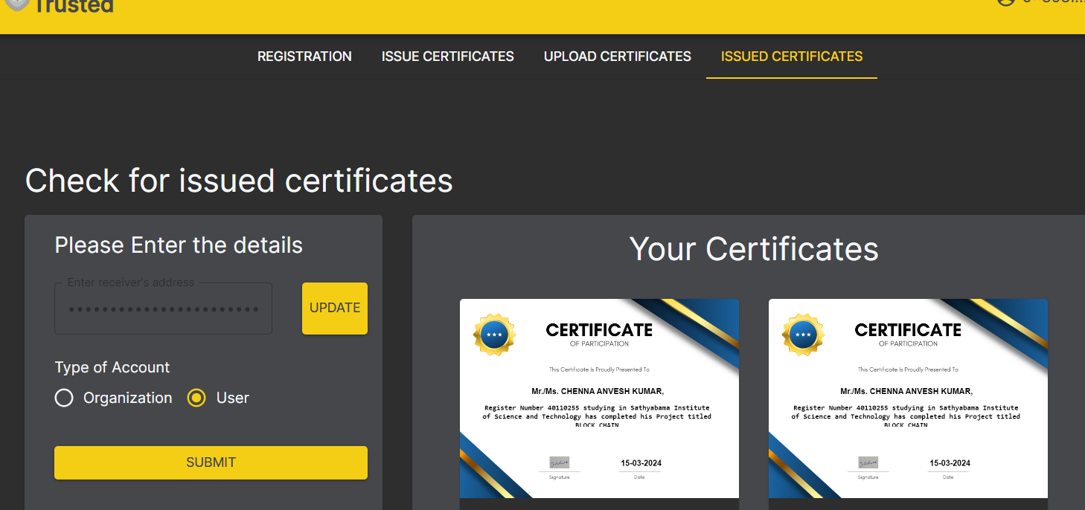
OUTPUT :

Slide 28
REFERENCES:
Kostopoulos, N., Antonopoulou, H., & Halkiopoulos, C. (2022). Blockchain Technology as an Asset for Innovative Educational Applications: A Systematic Review. EDULEARN22 Proceedings, 5783-5789.
Kumutha, K., & Jayalakshmi, S. (2022). Blockchain technology and academic certificate authenticity—A review. Expert Clouds and Applications: Proceedings of ICOECA 2021, 321-334.
Faaroek, S. A., Panjaitan, A. S., Fauziah, Z., & Septiani, N. (2022). Design and build academic website with digital certificate storage using blockchain technology. IAIC Transactions on Sustainable Digital Innovation (ITSDI), 3(2), 175-184.
Wang, Z., Li, M., Lu, J., & Cheng, X. (2022). Business Innovation based on artificial intelligence and Blockchain technology. Information Processing & Management, 59(1), 102759.
Xu, R., & Guan, E. (2023). Can blockchain innovation promote total factor productivity? Evidence from Chinese-listed firms. Applied Economics, 55(6), 653-670.
Shi, X., Yao, S., & Luo, S. (2023). Innovative platform operations with the use of technologies in the blockchain era. International Journal of Production Research, 61(11), 3651-3669.

Slide 29
THANK YOU

